Slide 1

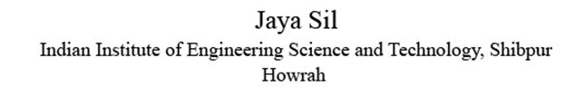
K-nearest neighbour classifier
Jaya Sil

Slide 2
kNN algorithm
k Nearest Neighbour (kNN) algorithm considers a dataset where each data point belongs to a known class.
We want to predict the class of a new data point based on the known classifications of the observations.
The class label of the new observation is chosen based on the similarity of the data points already classified.
Whether two observations are similar, we need to find some way of comparing the objects.

Slide 3
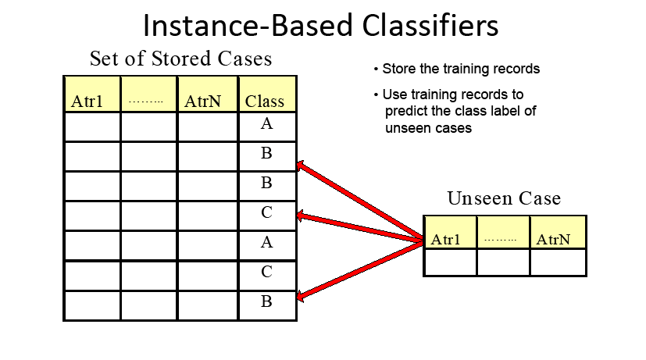

Slide 4
Measuring Similarity
Data points could be of many different types - it could be a number, a colour, a geographical location, true/false (boolean) answer to a question, etc - which would all require different ways of measuring similarity.
Preprocessing the data in such a way as to ensure that we can compare the observations.
Try to convert all characteristics into a numerical value.
Now we obtain a space in which each characteristics is represented and each observation with the characteristics is its coordinate.

Slide 5
Similarity
Our observations become points in space and we can interpret the distance between them as their similarity (using some appropriate metric).
The problem of deciding which observations from the dataset are similar enough to our new observation.
Considering all the data points within a certain radius of the new sample point, or by taking only a certain number of the nearest points.
In the k Nearest Neighbours Algorithm we consider the similarity of two points to be the distance between them in this space under some appropriate metric.

Slide 6
Prediction
Choosing the class to predict for a new observation is to pick the k closest data points to the new observation, and to take the most common class among these.
Step-1: Select the number K of the neighbors
Step-2: Calculate the Euclidean distance of K number of neighbors
Step-3: Take the K nearest neighbors as per the calculated Euclidean distance.
Step-4: Among these k neighbors, count the number of the data points in each category.
Step-5: Assign the new data points to that category for which the number of the neighbor is maximum.

Slide 7
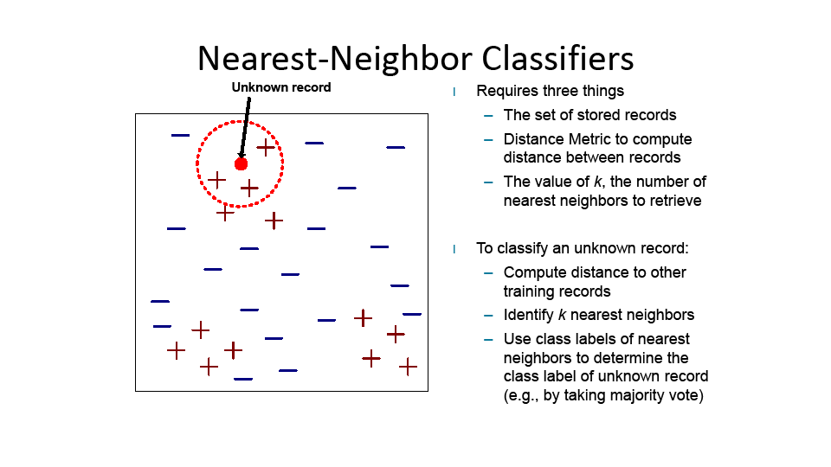

Slide 8
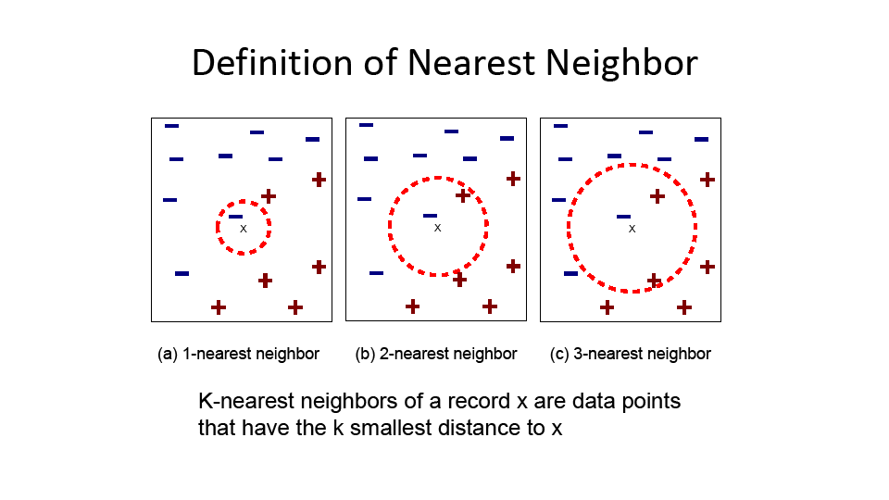

Slide 9
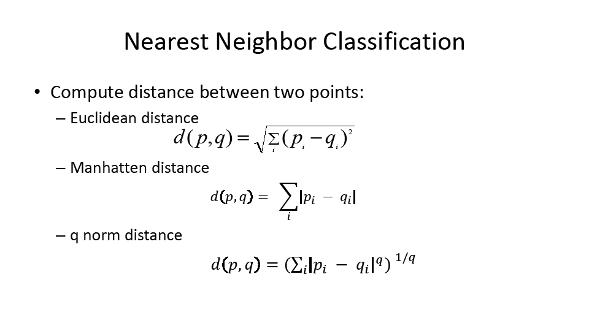

Slide 10
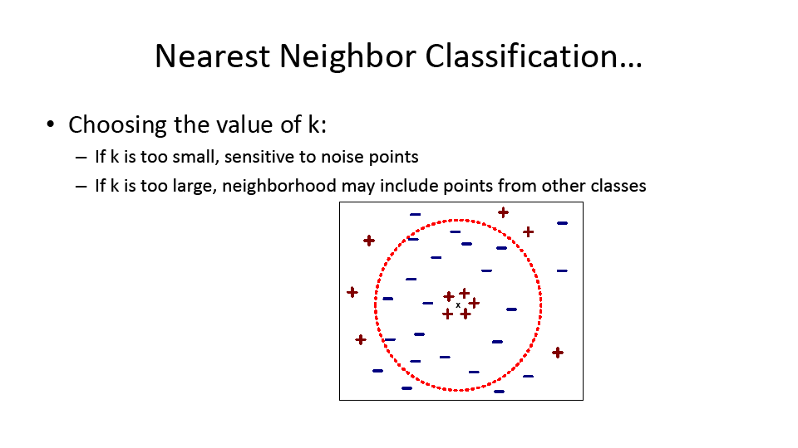

Slide 11
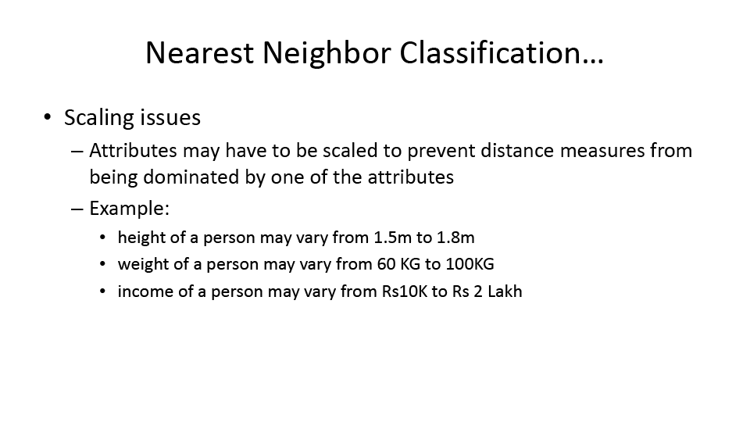

Slide 12
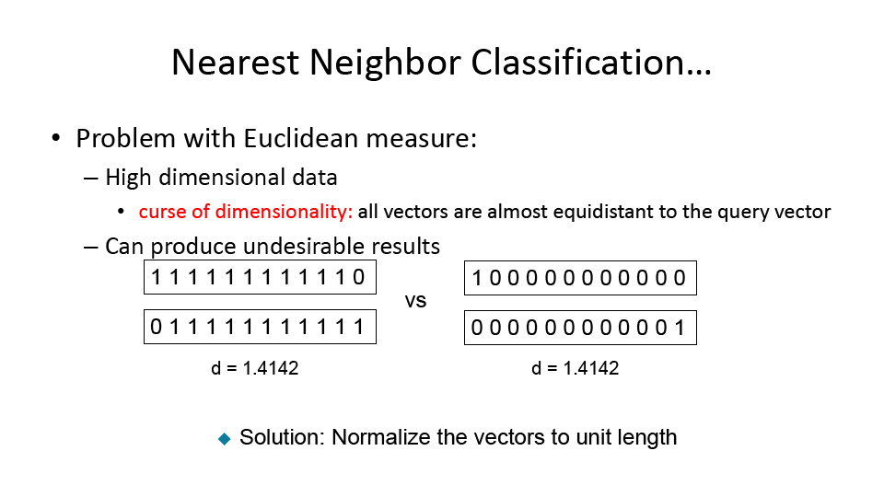

Slide 13
Properties
K-NN is a non-parametric algorithm, which means it does not make any assumption on underlying data.
It is also called a lazy learner algorithm because it does not learn from the training set immediately instead it stores the dataset and at the time of classification, it performs an action on the dataset.
KNN algorithm at the training phase just stores the dataset and when it gets new data, then it classifies that data into a category that is much similar to the new data.

Slide 14
How to select the value of K in the K-NN Algorithm?
There is no particular way to determine the best value for "K", so we need to try some values to find the best out of them. The most preferred value for K is 5.
A very low value for K such as K=1 or K=2, can be noisy and lead to the effects of outliers in the model.
Large values for K are good, but it may find some difficulties.

Slide 15
Advantages and Disadvantages
It is simple to implement.
It is robust to the noisy training data
It can be more effective if the training data is large.
Always needs to determine the value of K which may be complex some time.
The computation cost is high because of calculating the distance between the data points for all the training samples.

Slide 16
Thank you

